Slide 1
Dataiku Assignment
Sahaana Iyer | 18-01-2023

Slide 2
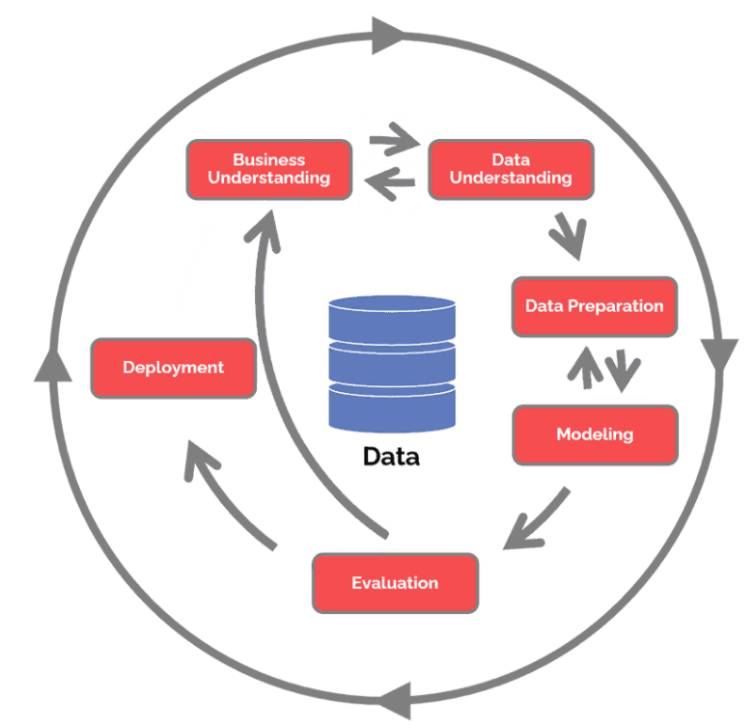
CRISP – DM Framework
The CRoss Industry Standard Process for Data Mining (CRISP-DM) is a process model with six phases that naturally describes the data science life cycle. It’s like a set of guardrails to help you plan, organize, and implement your data science (or machine learning) project.
Business understanding – What does the business need?
Data understanding – What data do we have / need? Is it clean?
Data preparation – How do we organize the data for modeling?
Modeling – What modeling techniques should we apply?
Evaluation – Which model best meets the business objectives?
Deployment – How do stakeholders access the results?

Slide 3
1) Business Understanding
Business Understanding
What is the use case ?
What is the end goal ?
What is the budget?
What are the various specifications ?
Objective

Slide 4
Census Income KDD Dataset
This data was extracted from the census bureau database found at
https://www.census.gov/data.html
Donor: Terran Lane and Ronny Kohavi
Data Mining and Visualization
Silicon Graphics.
e-mail: terran@ecn.purdue.edu, ronnyk@sgi.com for questions.
The United States Census Bureau leads the country’s Federal Statistical System; its primary responsibility is to collect demographic and economic data about America to help inform strategic initiatives. Every ten years, the census is conducted to collect and organize information regarding the US population with the intention of effectively allocating billions of dollars of funding to various endeavors (e.g., the building and maintenance of hospitals, schools, fire departments, transportation infrastructure, etc.). Additionally, the collection of census information helps to examine the demographic characteristics of subpopulations across the country.
Problem to identify :
For this technical assessment, you have been tasked with identifying characteristics that are associated with a person making more or less than $50,000 per year

Slide 5
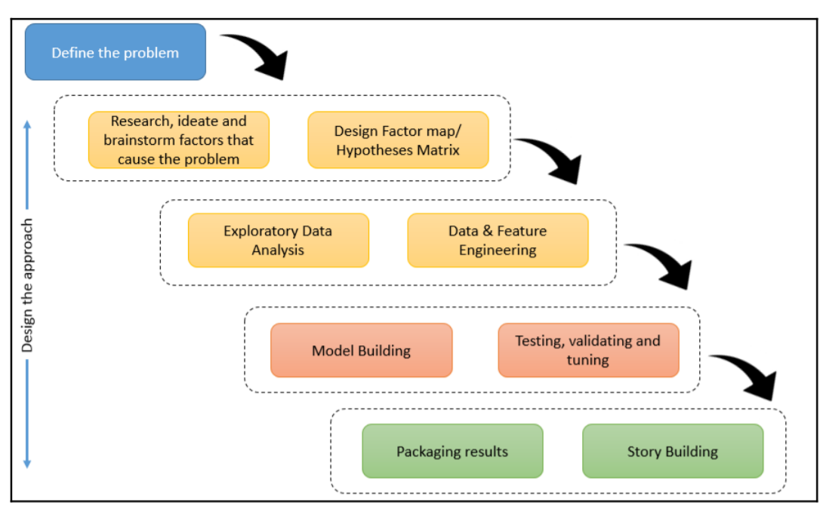
Designing the approach

Slide 6
2) Data Understanding
Objective
Data Understanding
Collect initial data
Describe data
Explore data
Verify data quality

Slide 7
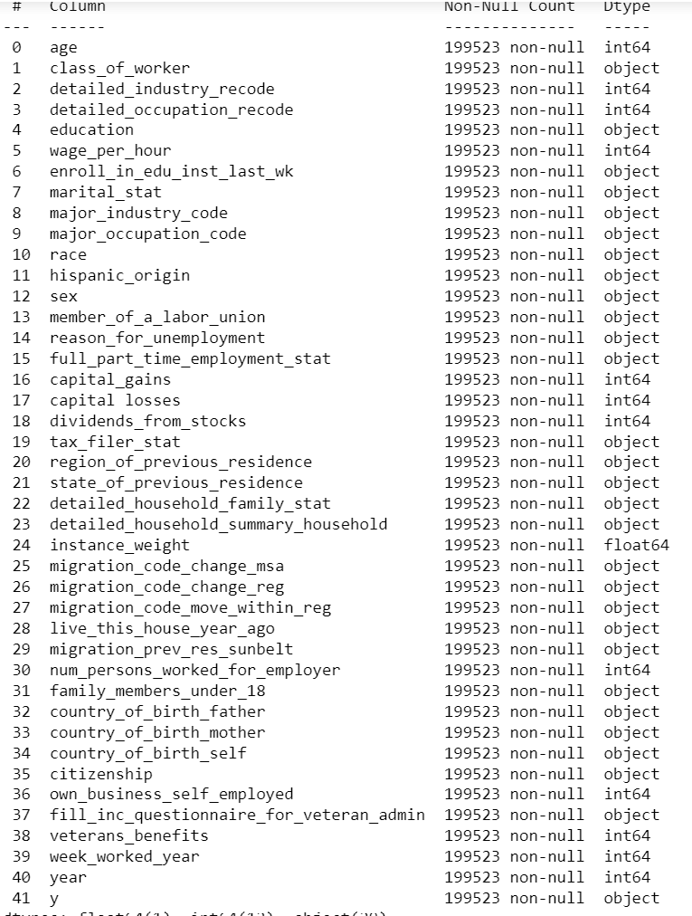
Data Structure
Objective

Slide 8
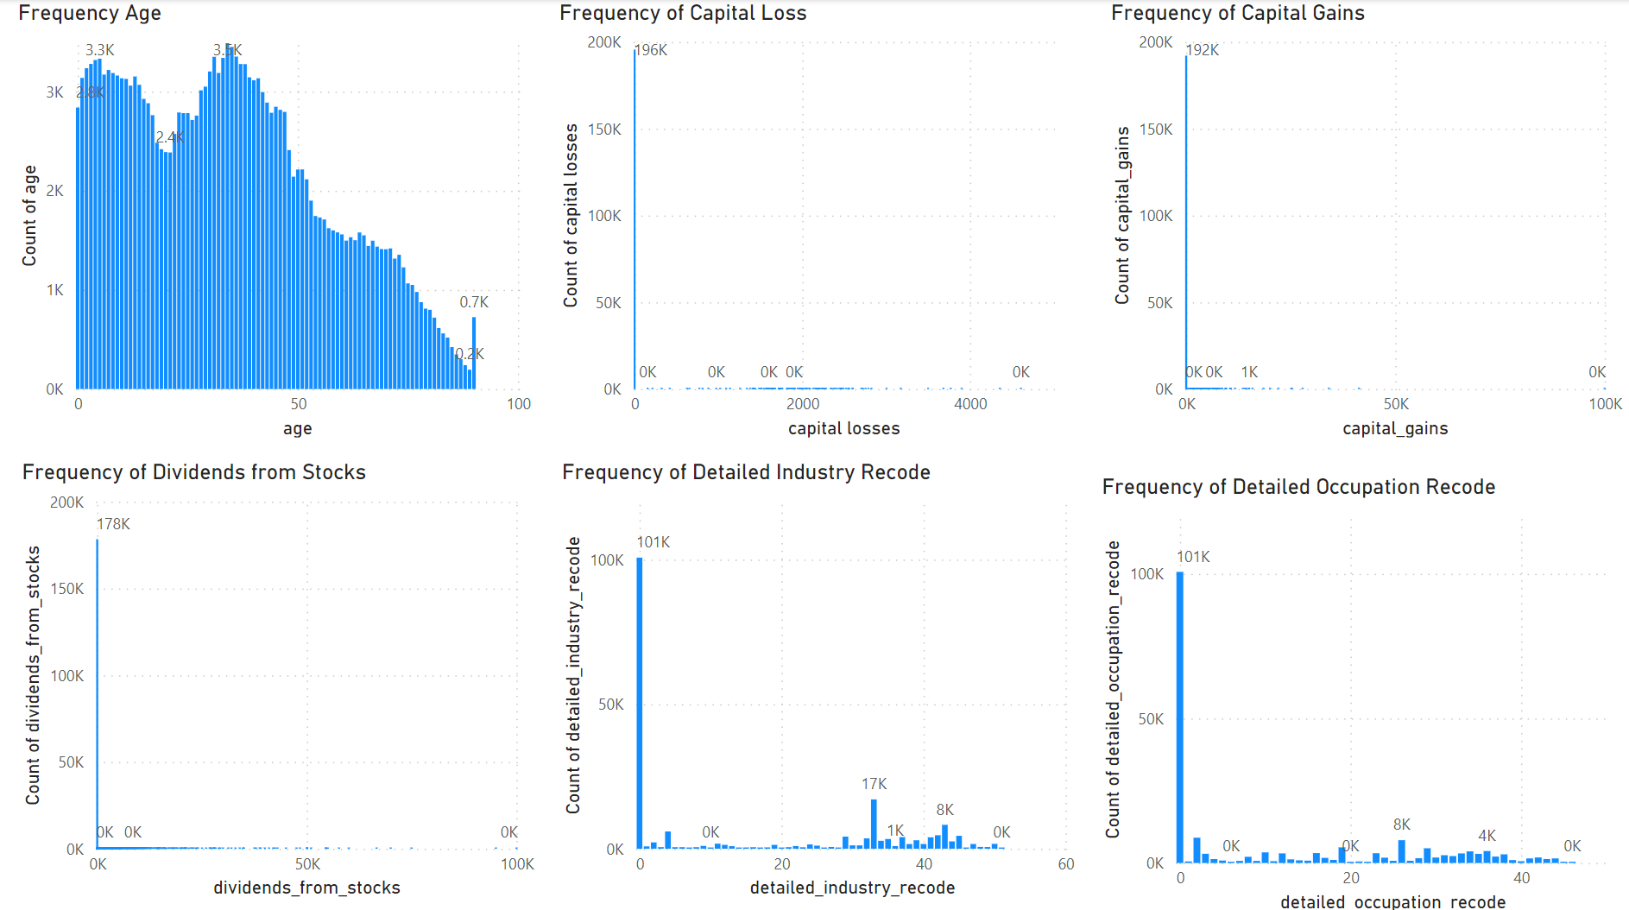
Data Visualization

Slide 9
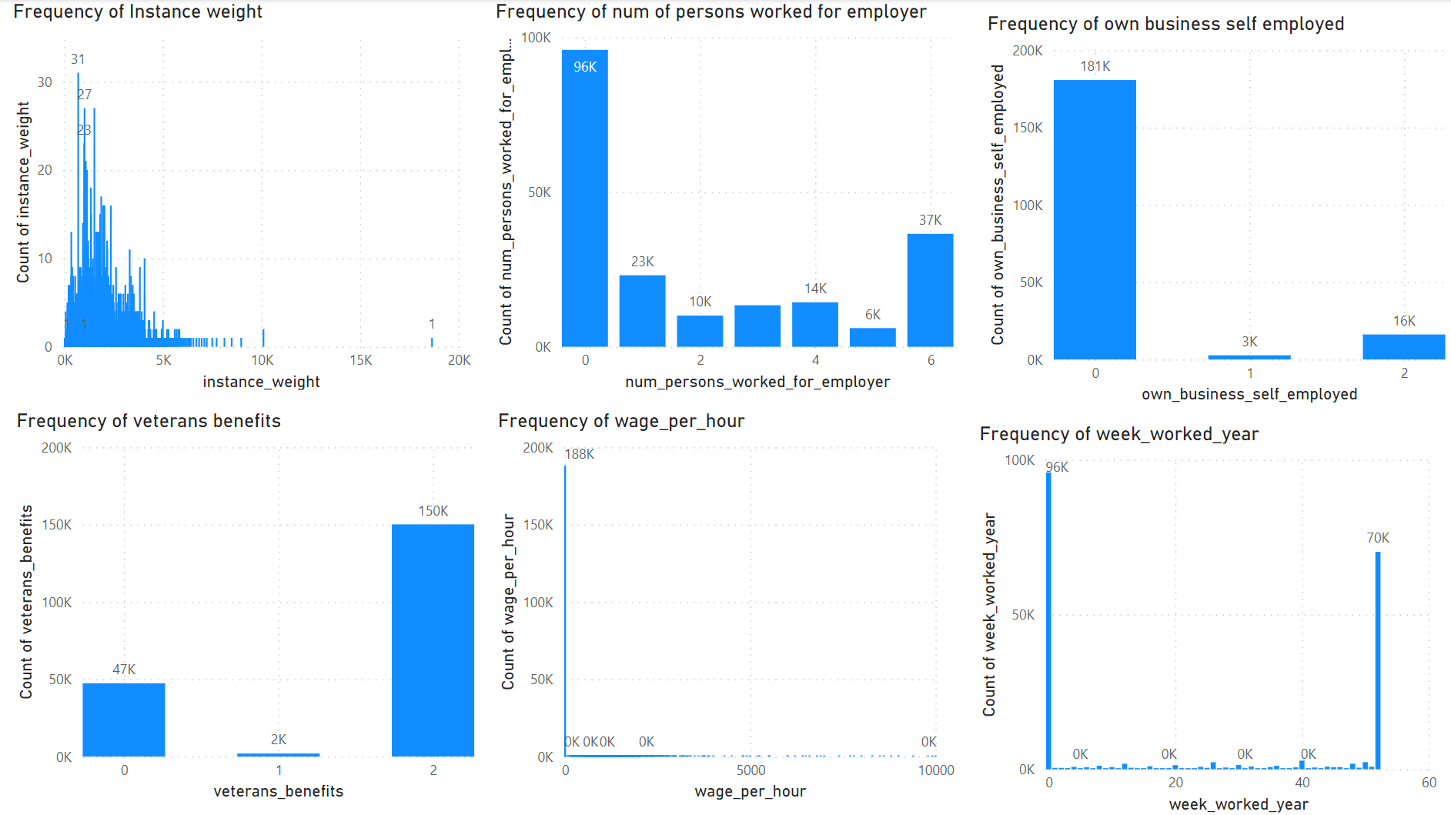
Data Visualization

Slide 10
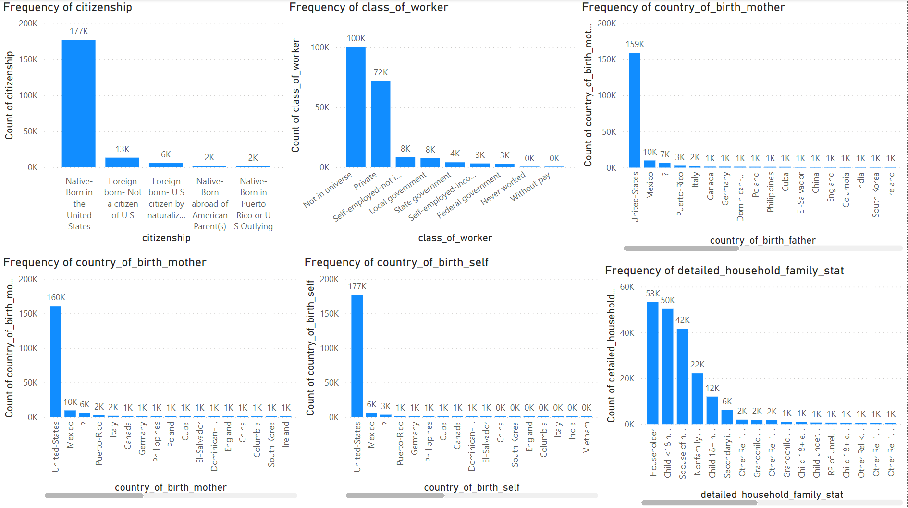
Data Visualization

Slide 11
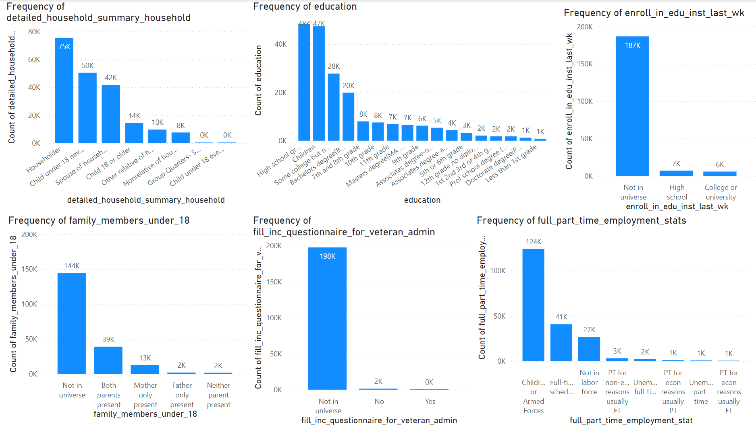
Data Visualization

Slide 12
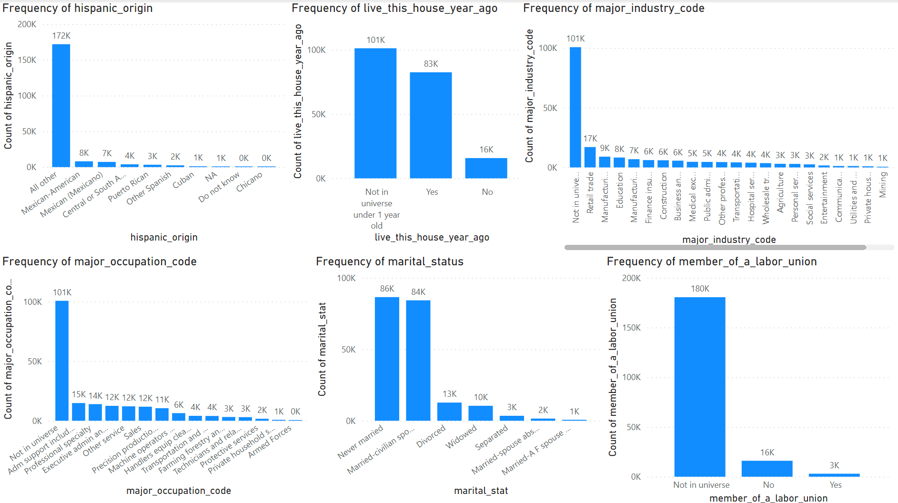
Data Visualization

Slide 13
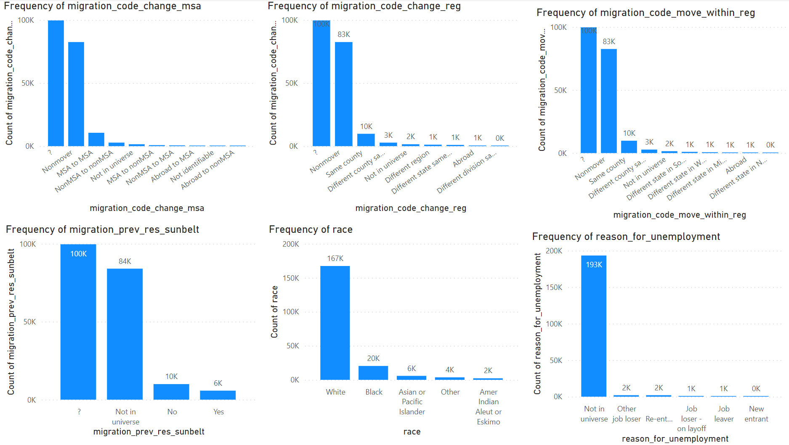
Data Visualization

Slide 14
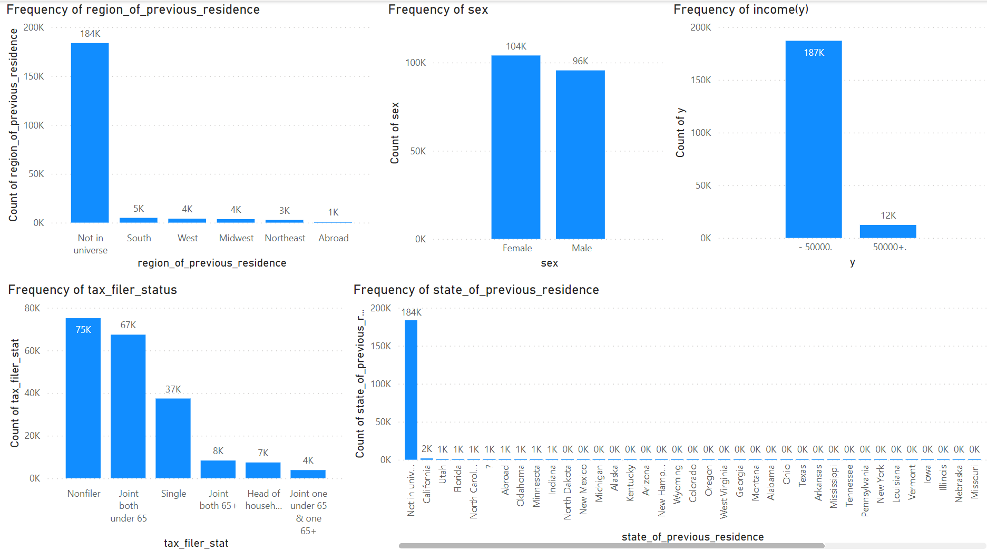
Data Visualization

Slide 15
Data Understanding
The data has 41 columns 31 has categorical variables and 10 as numeric variables.
From the frequency count chart we can see the 1994 and 1995 year data is present .
The income data is calculated based on many multiple categorical variables such as sex, race, marital status, veteran status ,etc.
The From the univariant analysis the column 'capital_gains', ‘capital_losses','dividends_from_stocks’ has more zero value.
Some categorical columns has value ‘?’ which has no meaning.
The categorical data ‘state from previous region’ and ‘region of previous region’ has more ‘Not in universe’
The data has more ‘-50000’ income when compare to ‘+50000’.

Slide 16
3) Data Preparation
Data Reduction
Using various strategies, reducing the size of data but yielding the same outcome.
Objective
Data Cleaning
Correcting inconsistent data by filling out missing values and smoothing out noisy data.
It involves normalization, transformation and aggregation of data using ETL methods.
Data Integration
Resolving any conflicts in the data and handling redundancies.
Data Transformation

Slide 17
Data Preparation
The data has ‘?’ which does not have any meaning so we have to convert the ‘?’ into null value.
From the univariant analysis the column 'capital_gains', 'capital_losses','dividends_from_stocks’ has more zero value so it wont be beneficial to use it for model creation it is better to delete the column.
The year column is not needed to pass into the model since our model can be used for different year for prediction.
The column instance weight is not needed since we are creating the classification model.
Objective

Slide 18
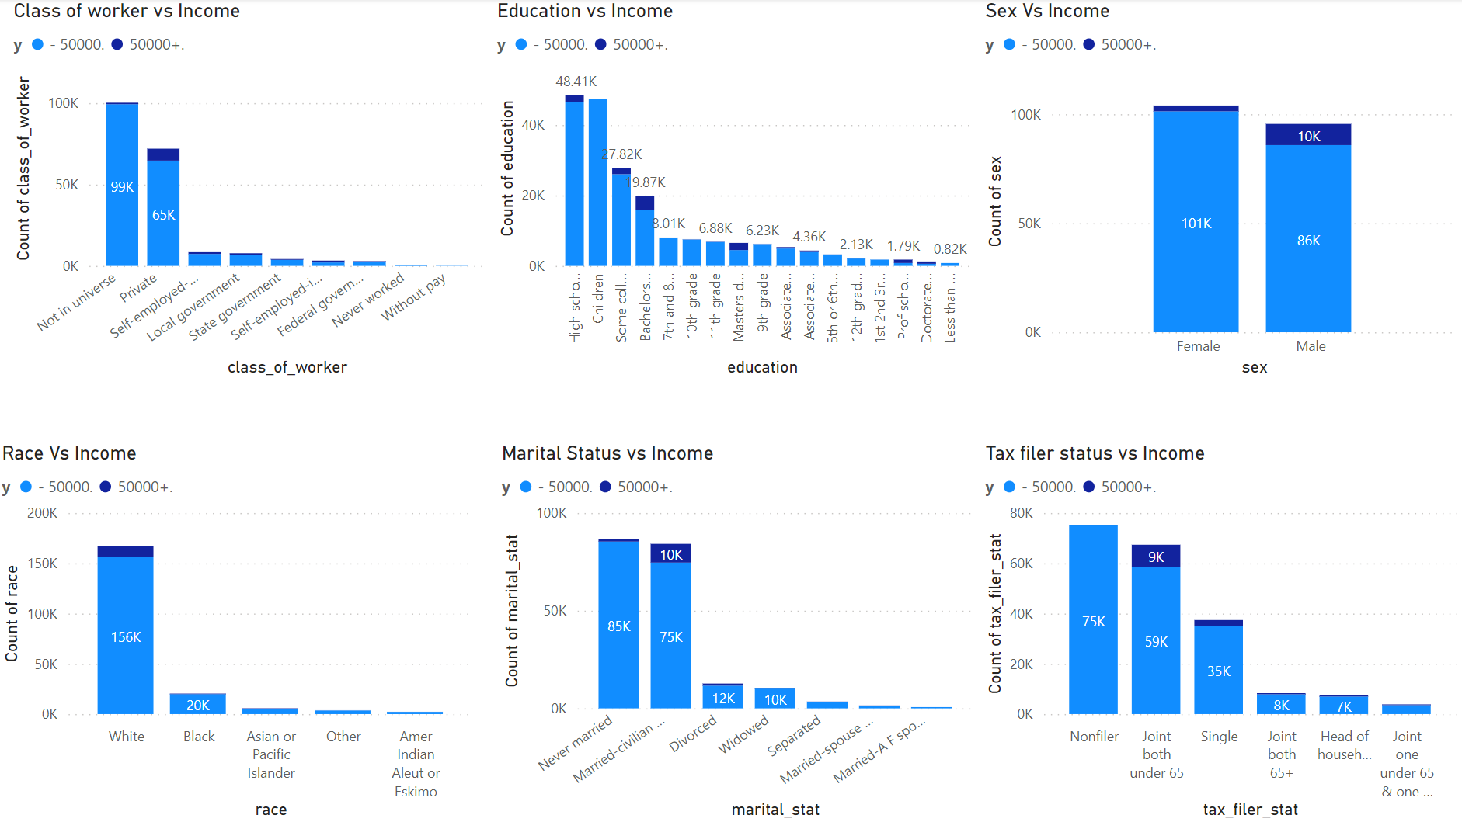
Bivariant Analysis
Objective

Slide 19
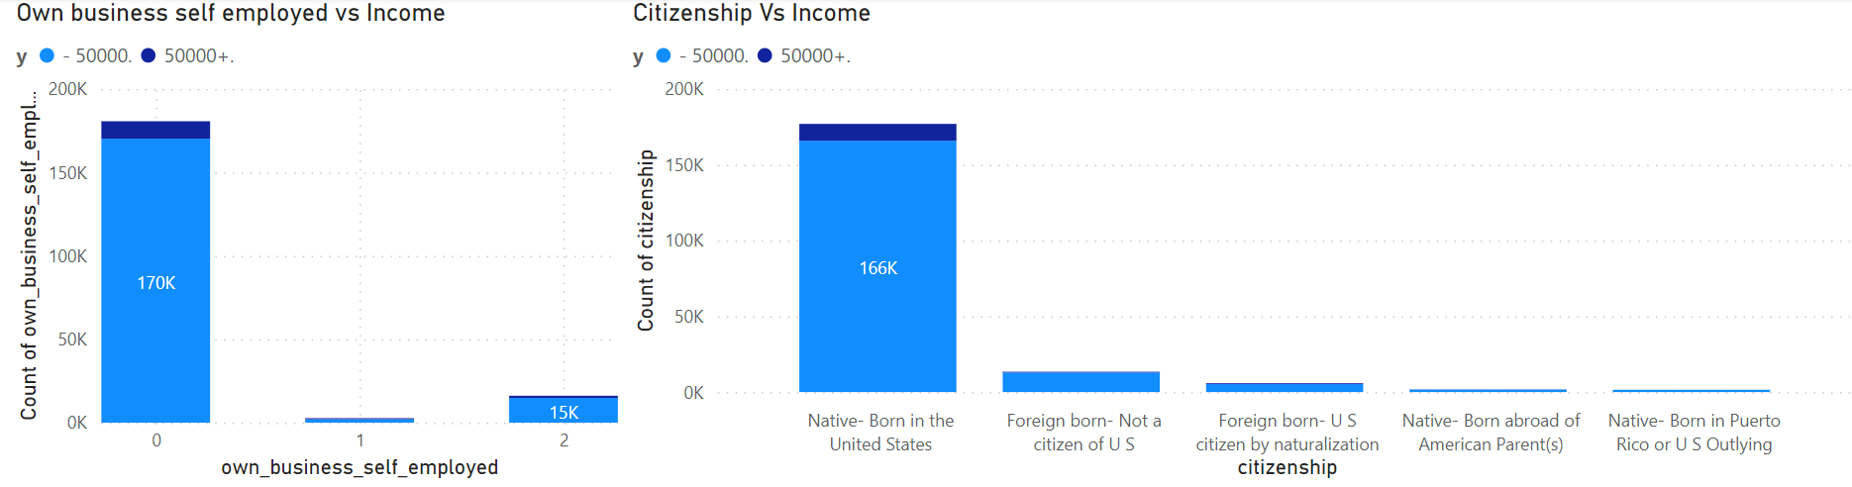
Bivariant Analysis
Objective
The categorical data ‘state from previous region’ and ‘region of previous region’ has more ‘Not in universe’ so it give any growth for the model development.

Slide 20
Bivariant Analysis
More than numerical data the categorical data has good relationship with the income column.
From the bivariant analysis the female comes under the ‘-50000’ income category more when compare to men.
In the class of work ‘Private’ sector has some ‘+50000’ income category when compared to other class of work.
In the education ‘Bachelor’ class has some ‘+50000’ income category when compared to other education.
In the race ‘White’ class has some ‘+50000’ income category when compared to other race.
In the marital status ‘Married or Civil Partnership’ class has some ‘+50000’ income category when compared to other marital status.
In the tax filed status ‘Joint both under 65’ class has some ‘+50000’ income category when compared to other tax filed status.
The own business and self employed comes under ‘-50000’ income category.
In the citizenship ‘Native – Born in US ’ class has some ‘+50000’ income category when compared to other citizenship.
Objective

Slide 21
4) Model Planning
Objective
Model Planning
Model Selection
Test Design
Model Development
Model Assessment

Slide 22
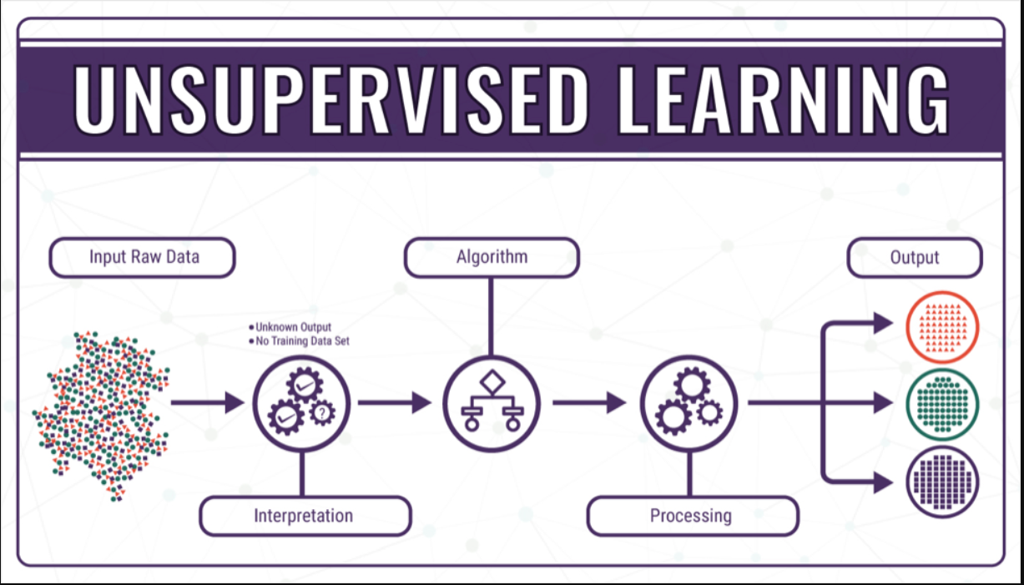
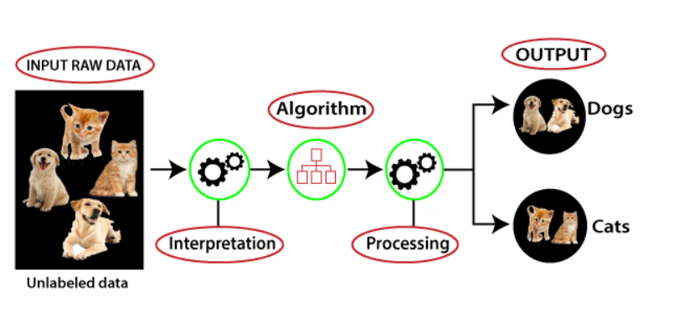
Unsupervised Learning
Unsupervised learning, also known as unsupervised machine learning, uses machine learning algorithms to analyze and cluster unlabeled datasets. These algorithms discover hidden patterns or data groupings without the need for human intervention. Its ability to discover similarities and differences in information make it the ideal solution for exploratory data analysis, cross-selling strategies, customer segmentation, and image recognition.
Algorithm Example : K means, One Class SVM, Isolation forest, etc.
General fields:
E commerce
Anomaly Detection
You Tube
Media services

Slide 23
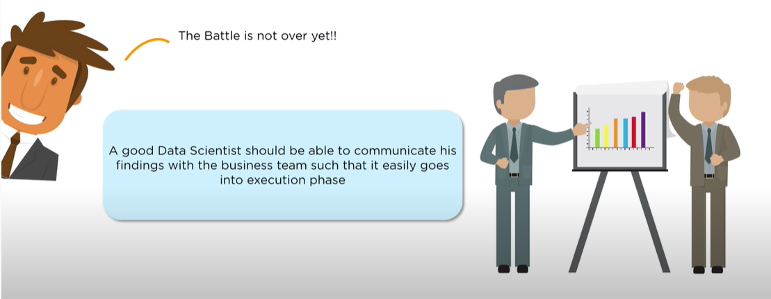
5) Evaluation
Objective

Slide 24
Model Comparison
For this problem statement we have used models which gives the good prediction for the classification model
Logistic regression
Decision Tree
Random forest
KNN
Model Name | Accuracy Score
Logistic regression | 94.45%
Decision Tree | 89.74 %
Random Forest | 94.14%
KNN | 94.49%
From the above table we can see KNN has more accuracy when compare to other models.

Slide 25
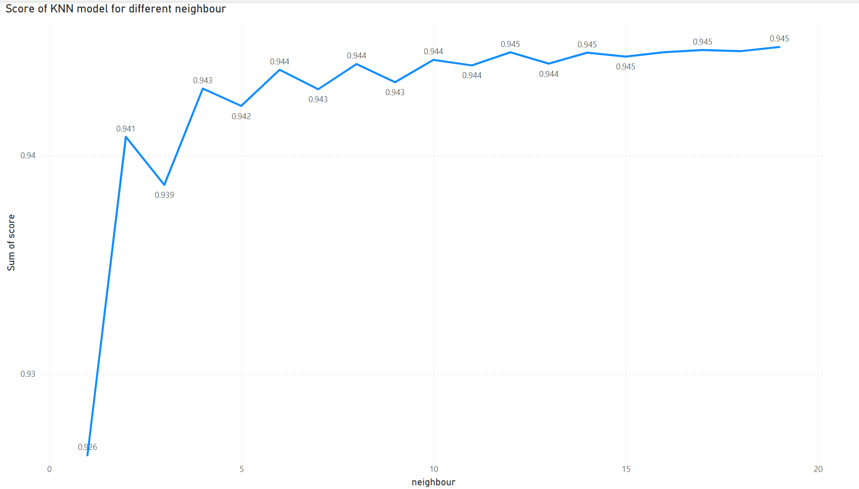
KNN neighbor comparison

Slide 26
Thank you
Sahaana Iyer
Mail ID : sagu1995@gmail.com
LinkedIn ID : https://www.linkedin.com/in/sahaana-venkat-a31997127/

